Slide 1
College Chatbot
PROJECT SUBMISSION REPORT
Presented By:
NAME – PANKAJ TYAGI
COLLEGE – Doon Institute of Engineering(D.I.E.T)
Department – Computer Science (C.S.E)

Slide 2
OUTLINE
Problem Statement
Proposed Solution
System Development Approach
Result
Overview
Conclusion
References

Slide 3
Problem Statement
The current communication and information retrieval systems in our college are outdated and do not effectively cater to the dynamic needs of the academic community. Students, faculty, and staff often face difficulties in accessing essential information, obtaining quick responses to queries, and navigating through the students perspective.

Slide 4
Proposed Solution
In response to the challenges faced by the academic community in accessing information and obtaining quick responses, our proposed solution involves the implementation of an advanced Chabot system powered by IBM Watson Assistant.
Key Features:
Understands Natural Language: Talks like a human and understands what people ask.
Personalized Help: Gives customized answers based on each person's needs.
Learns and Gets Better: Gets smarter over time as it learns from interactions.
Implementation Plan:
Development: Utilize IBM Watson Assistant to design and develop the chatbot, customizing it to align with our college's specific requirements..
Testing and Validation: Conduct rigorous testing and validation procedures to ensure the functionality, accuracy, and usability of the Chabot across various scenarios.
Launch It: Make it available for everyone to use.
Deployment:
Deploy the Chabot across relevant platforms and channels, making it readily accessible to the college community.
Evaluation:
Accuracy: Assess the chatbot's ability to provide correct and relevant responses to user queries.
User Satisfaction: Gather feedback from users to evaluate their overall satisfaction with the Chatbot's performance and usability.
Integration: Ensure seamless integration with existing systems and platforms within the college environment.

Slide 5
System Approach
The System required for creating the Chatbot was presented by IBM Watson x Assistant.
Steps to go to the Watson x Assistant services are:
You have to create an account on IBM cloud and enter your feature code generated in the 1st week of the internship.
Once you have created the account, then you can search for the Watson x Assistant in IBM cloud .

Slide 6
Result
You can see the result by visiting these links:
Chatbot Link : https://web-chat.global.assistant.watson.appdomain.cloud/preview.html?backgroundImageURL=https%3A%2F%2Fau-syd.assistant.watson.cloud.ibm.com%2Fpublic%2Fimages%2Fupx-9afdf6b0-dc14-4ac9-ad2c-553c08ff0e4c%3A%3Acecc02da-bb78-4724-addb-c3a7bc498504&integrationID=a1df26ec-21c2-415d-b08f-1f4d1cdc285a&region=au-syd&serviceInstanceID=9afdf6b0-dc14-4ac9-ad2c-553c08ff0e4c
Website Link : https://collegechatbot.tiiny.site

Slide 7
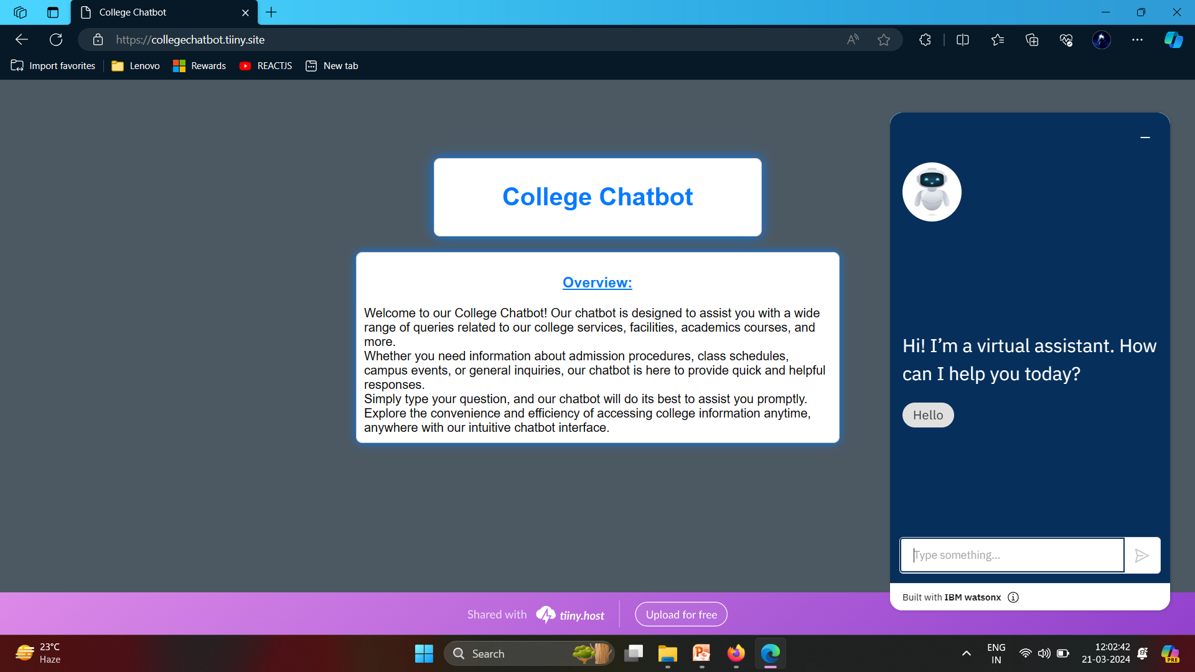
Overview

Slide 8
Conclusion
By implementing an IBM Watson Assistant Chatbot, we aim to address the existing communication and information retrieval challenges within our college community, fostering enhanced collaboration, efficiency, and satisfaction among students, faculty, and staff.

Slide 9
References
IBM Cloud. (n.d.). Watson Assistant. Retrieved from https://www.ibm.com/cloud/watson-assistant
IBM Developer. (n.d.). IBM Cloud Watson Assistant Documentation. Retrieved from https://cloud.ibm.com/docs/watson?topic=watson-about
The courses and some academics details are taken from UTU(Uttarakhand Technical University).

Slide 10
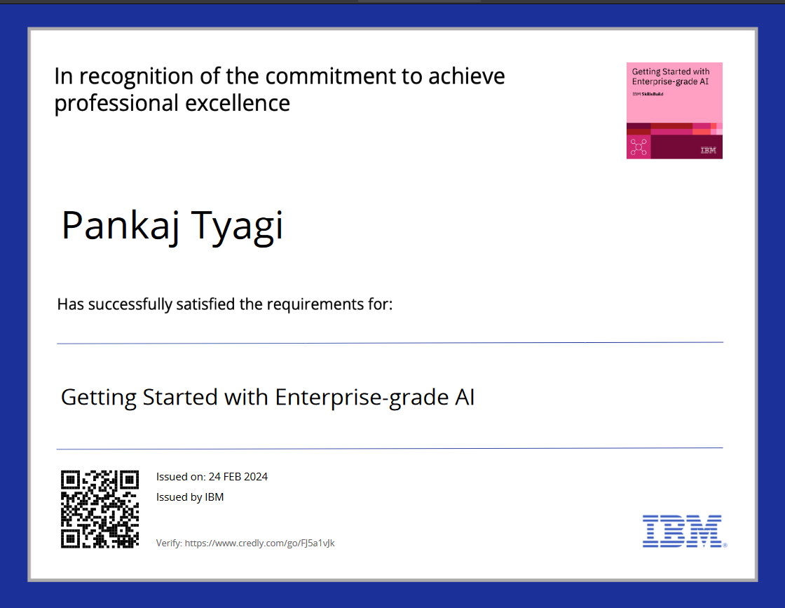
course certificate 1

Slide 11
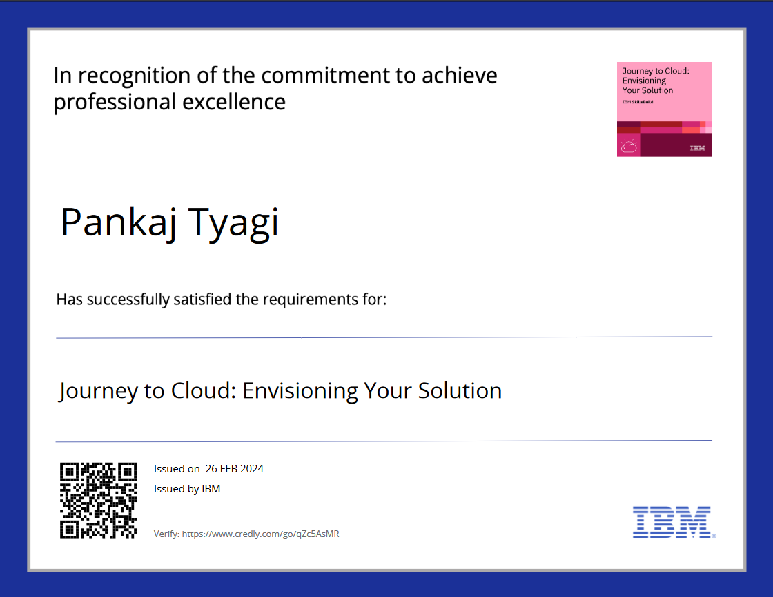
course certificate 2

Slide 12
THANK YOU

